Slide 1

Anomaly Activity Recognition Using ML
Group Number: 8
Mentor – Prof Renuka Devi
Presented By
Sahana N (ENG16CS0134) Mohammed Aasif (ENG18CS1OO3) V Maheshwari Sanjana (ENG17CS0236) Yash Advani (ENG17CS0254))

Slide 2
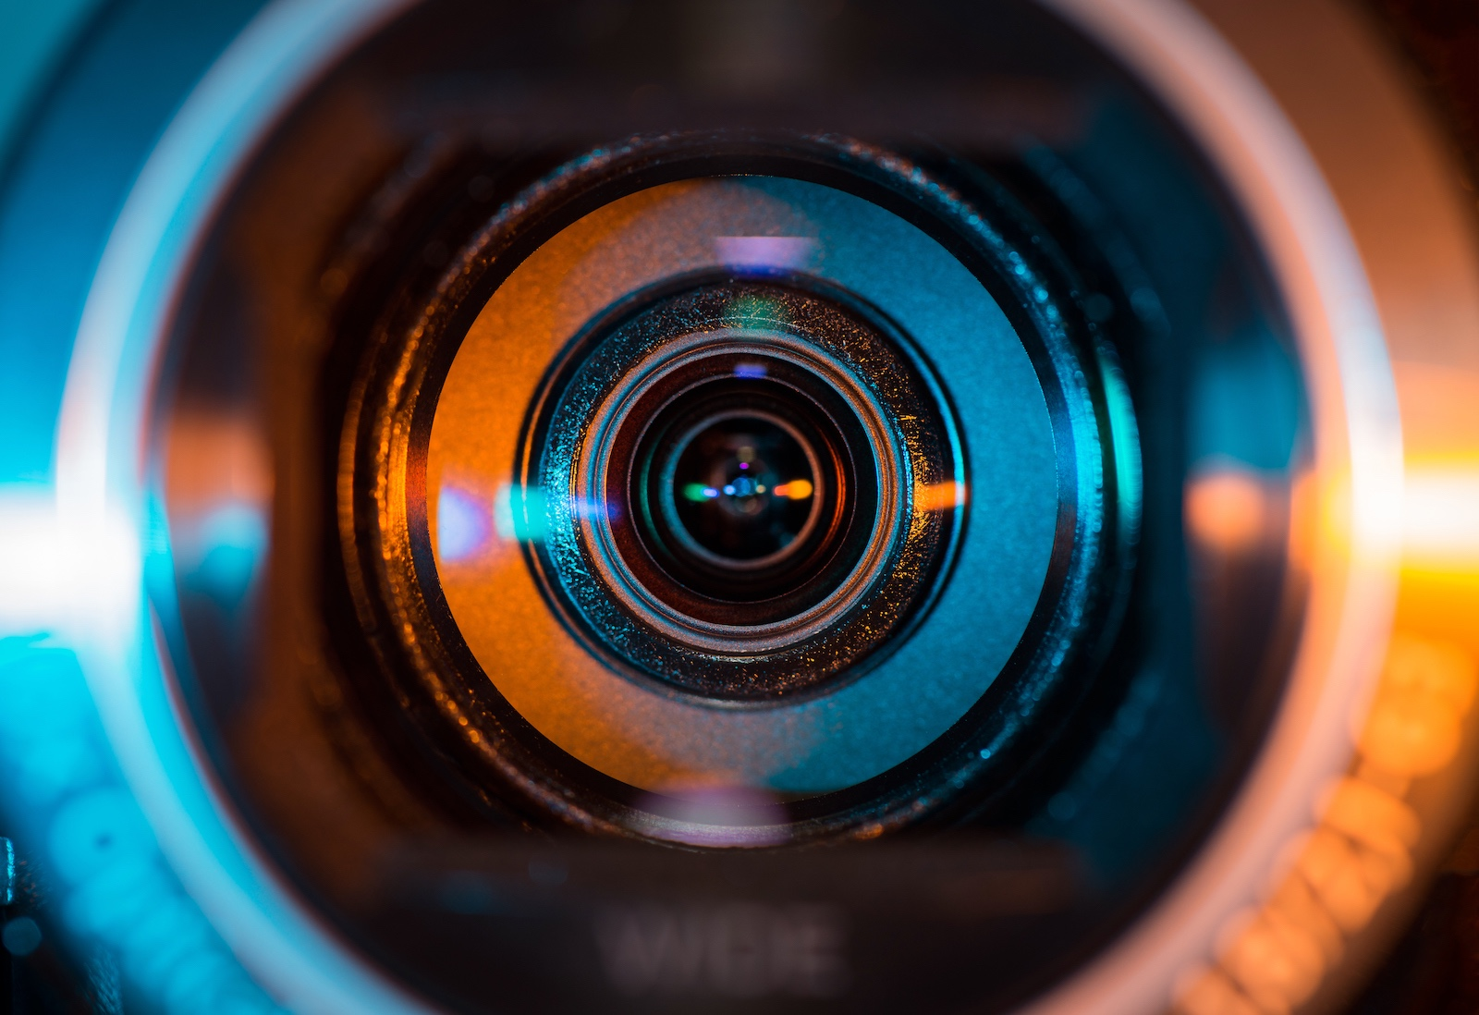
CONTENT
INTRODUCTION
PROBLEM STATEMENT
LITERATURE SURVEY
REQUIREMENT ANALYSIS
BLOCK DIAGRAM
METHODOLOGY
FLOW CHART
ARCHITECTURE DIAGRAM
RESULTS ANALYSIS
CONCLUSION & FUTURE WORK
REFERENCES

Slide 3
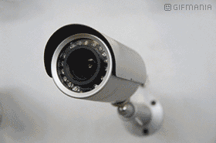
INTRODUCTION
In the current era, the majority of public places are under video surveillance.
There is a need to provide essential security and monitor unusual anomaly activities at such places.
The major drawback is that there is a need to perform manual operation for detecting anomaly which lead to possibilities of human errors.
This project focuses on developing a platform for analyzing frames from the datasets and generate alerts.
This system is capable to recognize an abnormal event in each frame and generate a notification of such an event.
The results are displayed on the screen where the users can interact with the visualizations and see the status in real-time.
Commonly used for:
-Remote video monitoring
-Facility protection
-Monitor operations
-Parking lots

Slide 4
PROBLEM STATEMENT
“This system is designed for monitoring its main objective which is the Normal and Abnormal activity recognition from surveillance video divided into frames using Machine Learning and create alerts.”

Slide 5
LITERATURE SURVEY
Human Activity Recognition in Smart Home With Deep Learning Approach:
(Homay Danaei Mehr, Huseyin Polat ; 2019)
In this study in order to recognize human action of a smart home video dataset (DMLSmartActions) Convolutional Neural Networks (CNNs) architecture as a deep learning model has been proposed. This architecture may not be a sufficient model for any other datasets.
Abnormal Human Activity Recognition using Bayes Classifier and Convolutional Neural Network :
(Congcong Liu, Jie Ying*, Feilong Han, Ming Ruan ; 2018)
The method uses Bayes Classifier and Convolutional Neural Network to detect four activities, including walking, running, punching and tripping. Convolutional Neural Network performs better than Bayes Classifier in the experiment.

Slide 6
Activity recognition using Neural Network:
Mohanad Babiker1 , Othman O. khalifa1 , Kyaw Kyaw Htike2 , Aisha Hassan1 , Muhamed Zaharadeen1 ; 2017
An intelligent human activity system recognition is developed using Neural Network. Where the system will detect different activities like walking, hand waving, sitting, boxing. But, , recognition of the activity cant be done in an traffic area . It is only preferrable for indoors.
Study on Machine Learning and Deep Learning Methods for Human Action Recognition :
In this work, we outline most recent works and present a survey of researches in vision-based human action recognition techniques including action classification (especially on the action representation methods of action classification) and deep-learning methods.

Slide 7
REQUIREMENT ANALYSIS
System Requirements :
The system should be capable to run in real time video surveillance frames
The false positive rate must be minimal
The system should be capable of alerting during anomaly
The system must be able to perform with high accuracy even in crowded places

Slide 8
Software Requirement:
Operating system : Windows XP/ Windows 7.
Software Tool : Open CV Python
Coding Language : Python
Software Library : Tensorflow , Keras
Hardware Requirement:
Laptop or desktop with windows latest version (preferred)
8GB ram
Intel i5 core processor
4GB graphic card min

Slide 9
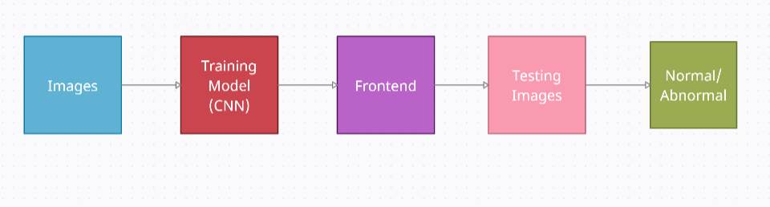
BLOCK DIAGRAM

Slide 10



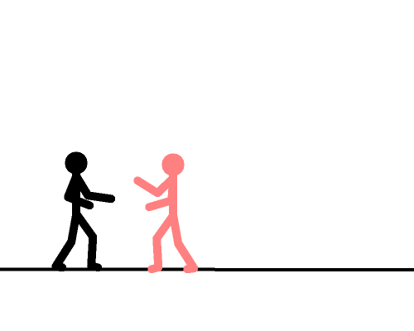
DATASET
UMN dataset
Avenue dataset
Cavier test case scenarios dataset

Slide 11
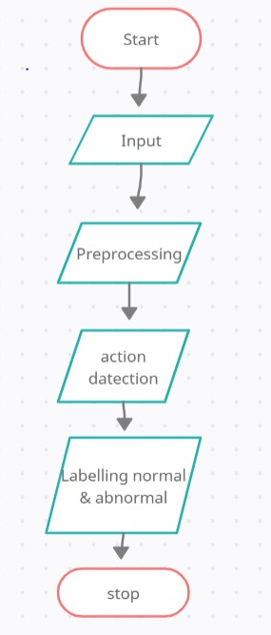
FLOW CHART

Slide 12
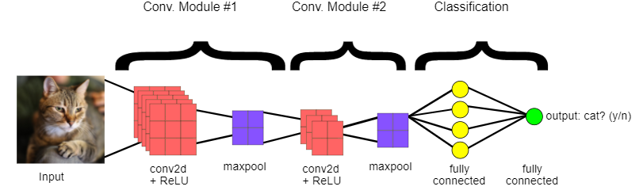
METHODOLOGY
In cnn model we are using four layers for feature extraction and classification that is
2D Convolutional layer
ReLu layer
Max pooling layer
Fully connected layer

Slide 13
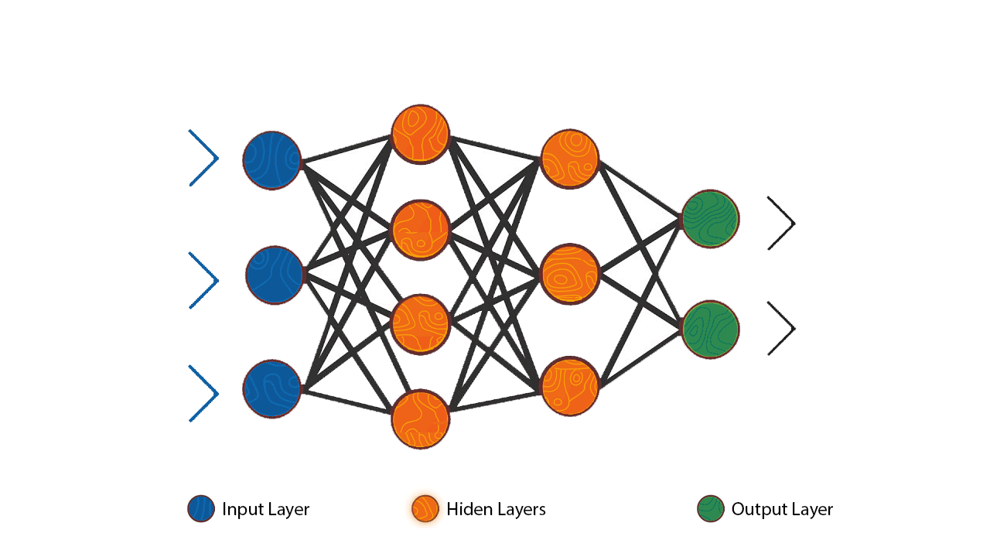
Step I: CNN Model
The first step is to create CNN model.
Train the model with large number of images.
The model is being trained for different actions like chasing, walking, fighting, falling, Leaving packages, running etc.,
Preprocess of the dataset frames is done to resize the images and training the model using cascade trainer.
Finally the CNN model is created.

Slide 14
Step II:
The already trained CNN model is being used and connected to a new frontend page.
Front end with GUI is created where the users can interact with the visualizations and see the status in real-time .
Here it leads to a welcome window, which redirects to next window.
Then the second window is where the image is fetched, analyzed and output is predicted by using cnn in the back end
The front end is done using tkinter and back end using tensorflow ,Keras which is used for loading the model.

Slide 15
After the image is analyzed , the system will display the output by recognizing the action whether the image is normal or abnormal.
Once the image is analyzed it will also create an alert by playing sound to the user according to the event detected
Based on the accuracy received after training the model , a accuracy matrix is plotted using matplot library.

Slide 16
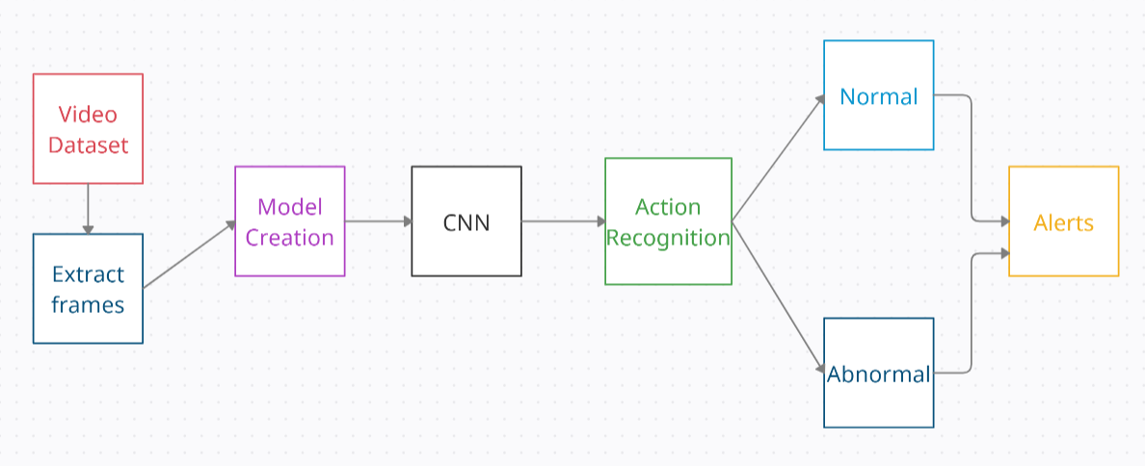
ARCHITECTURE DIAGRAM

Slide 17
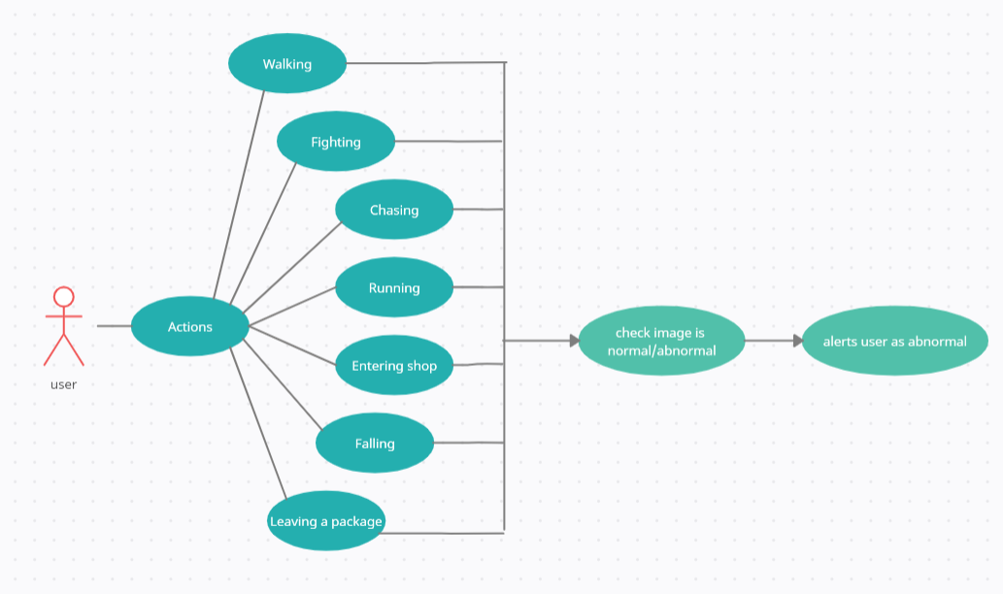
USE CASE DIAGRAM

Slide 18
PROS
This system can be used for any image taken from public sites of any datasets as well.
It gives the results instantly.
The computational speed is efficient.
The training accuracy of the model is 95%
It gives alerts if the system is abnormal or normal.

Slide 19
CONS
This system can be utilized for frames but not in video form.
More than one frame cant be taken as input instanly.

Slide 20
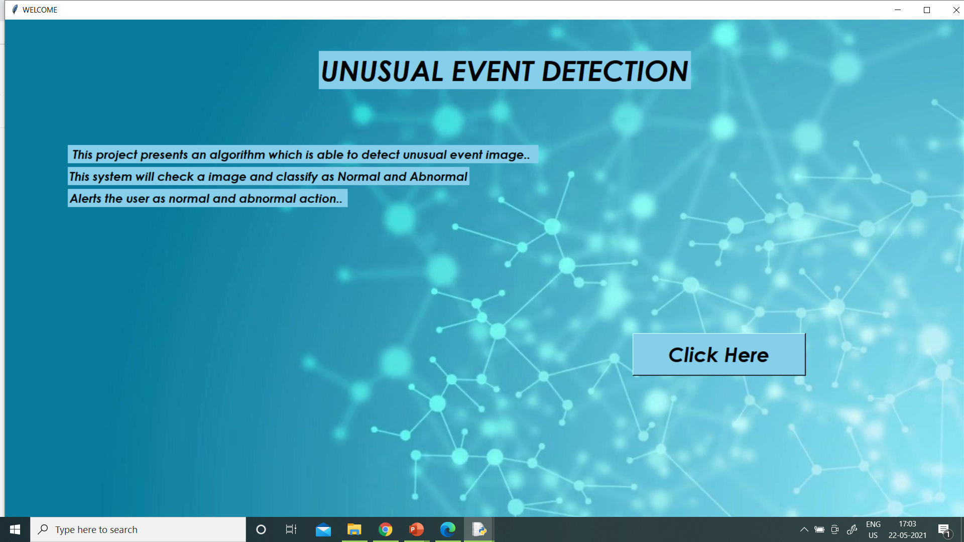
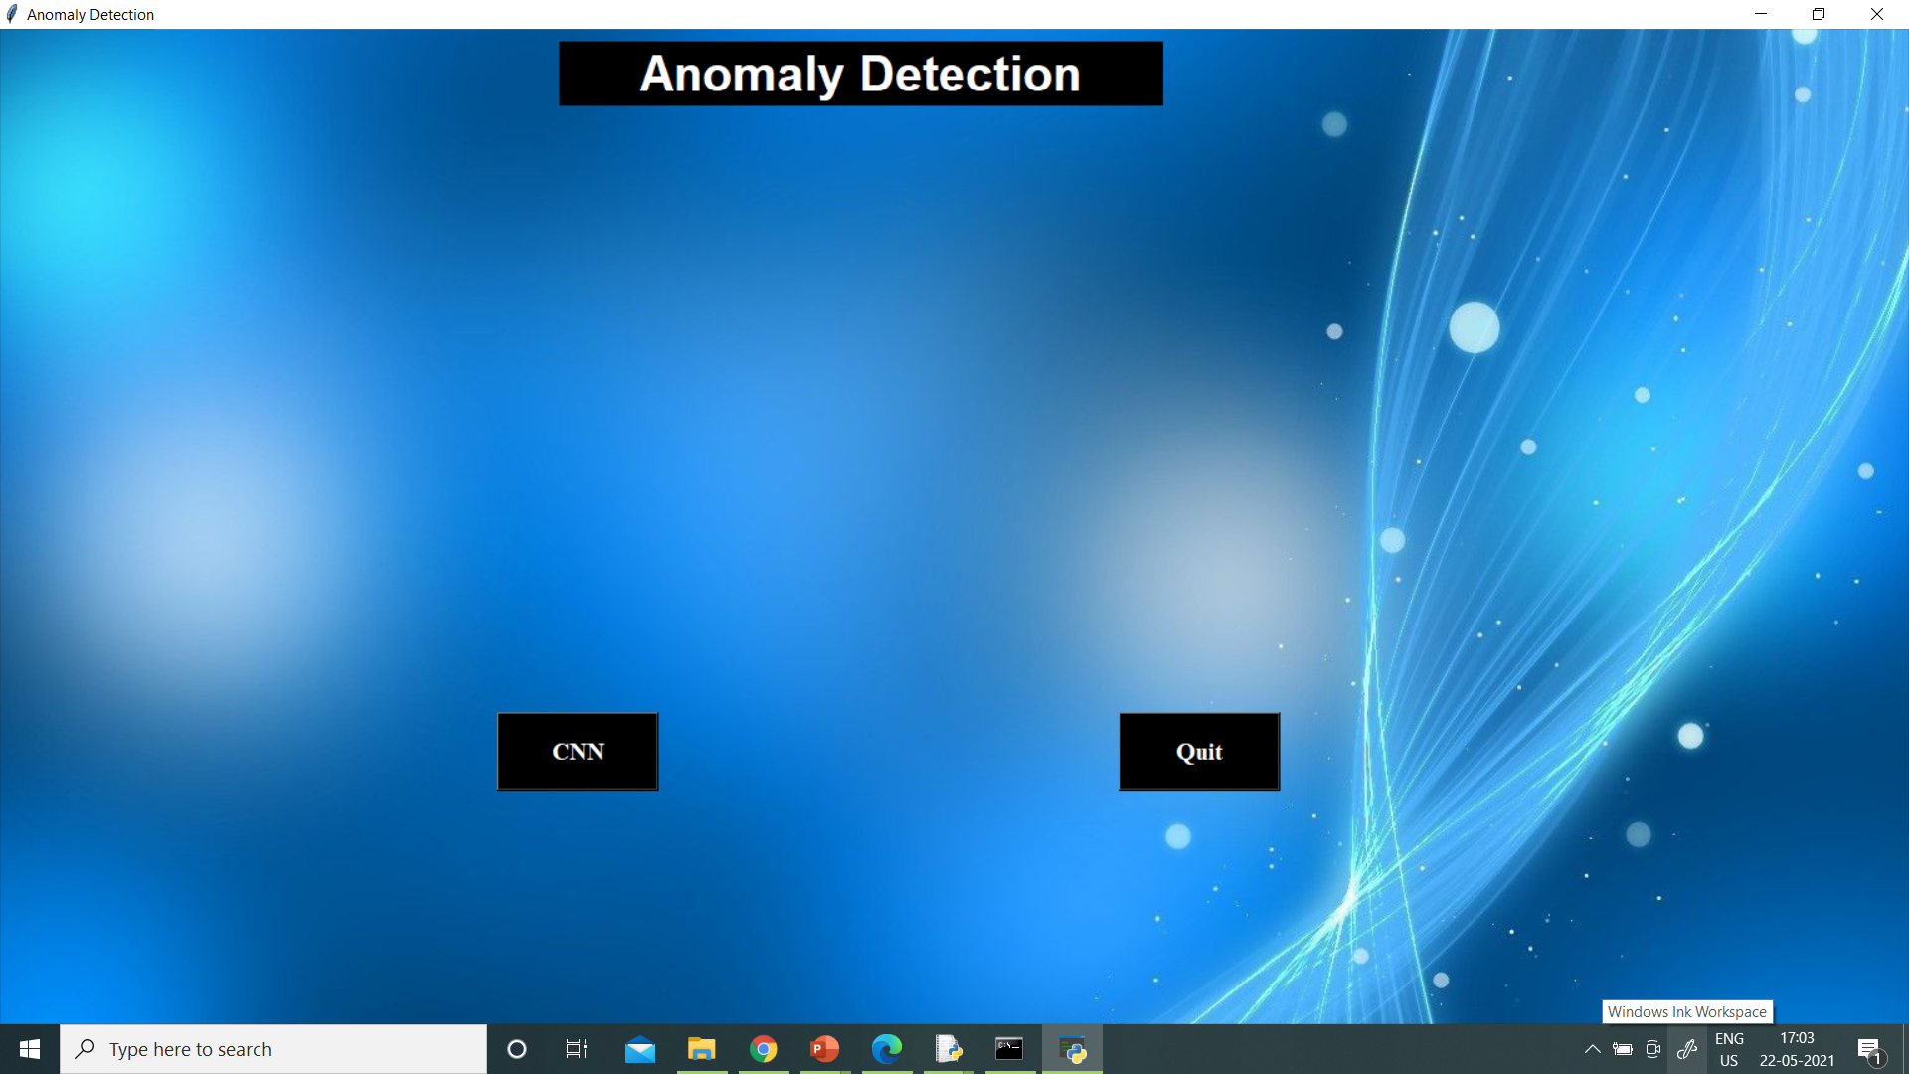
RESULT ANALYSIS

Slide 21
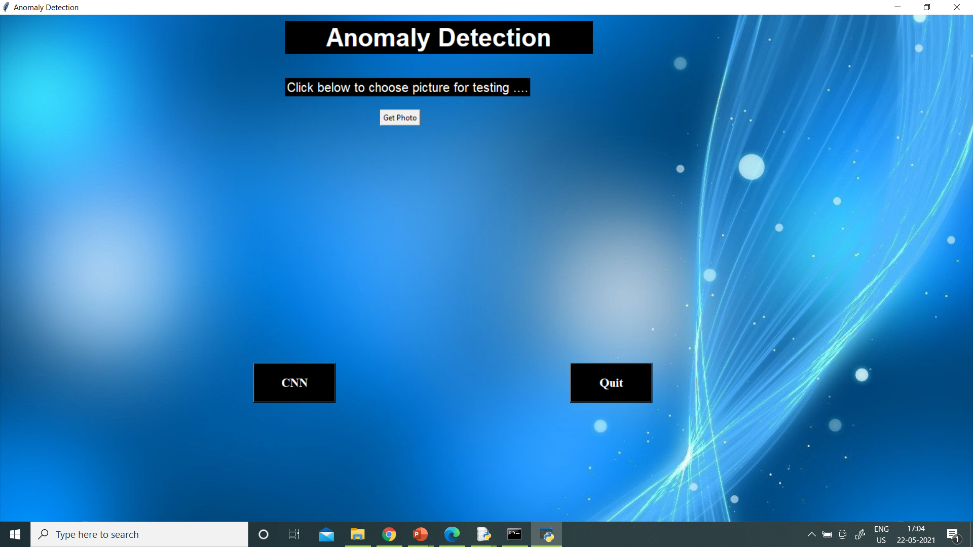
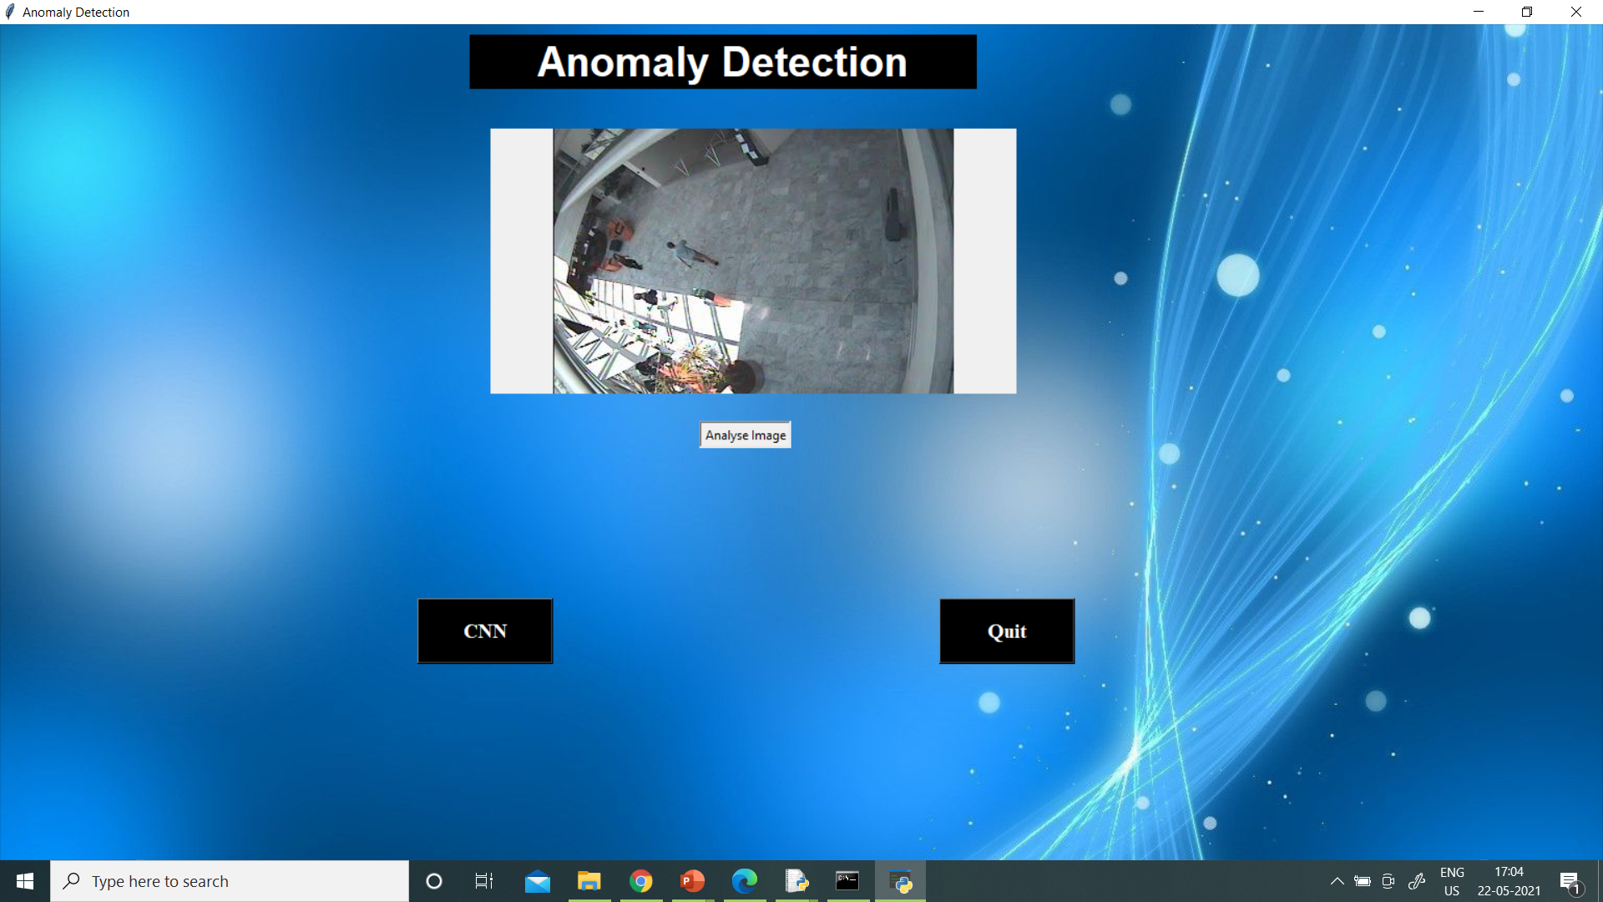

Slide 22
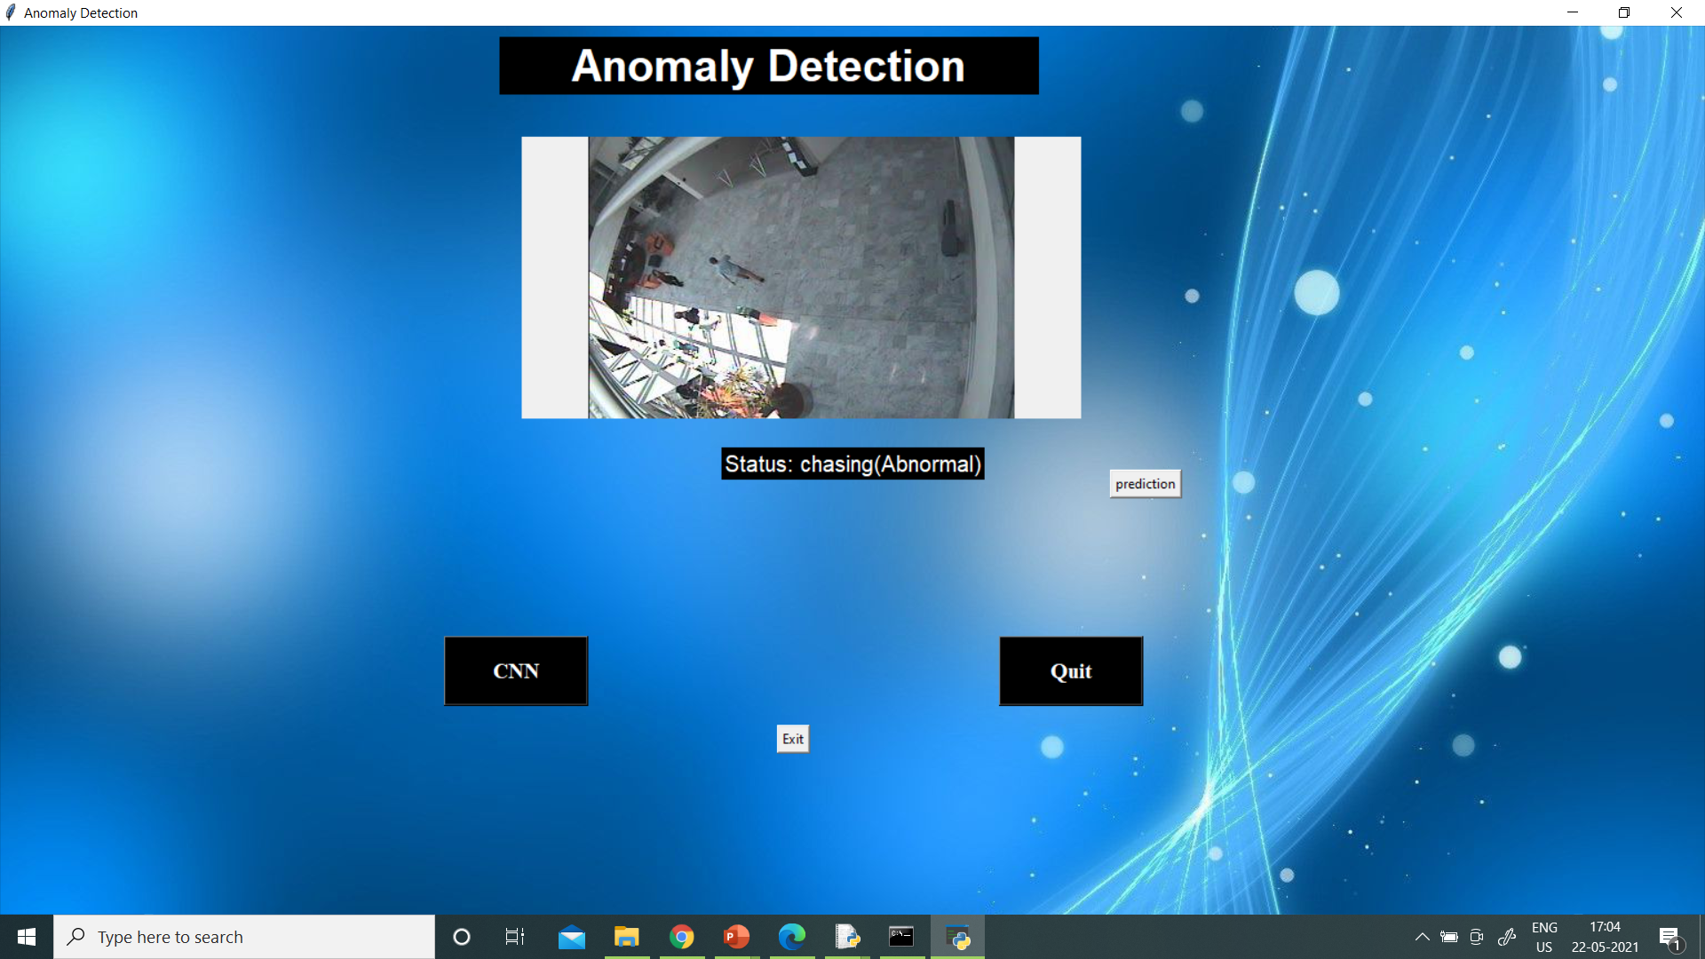
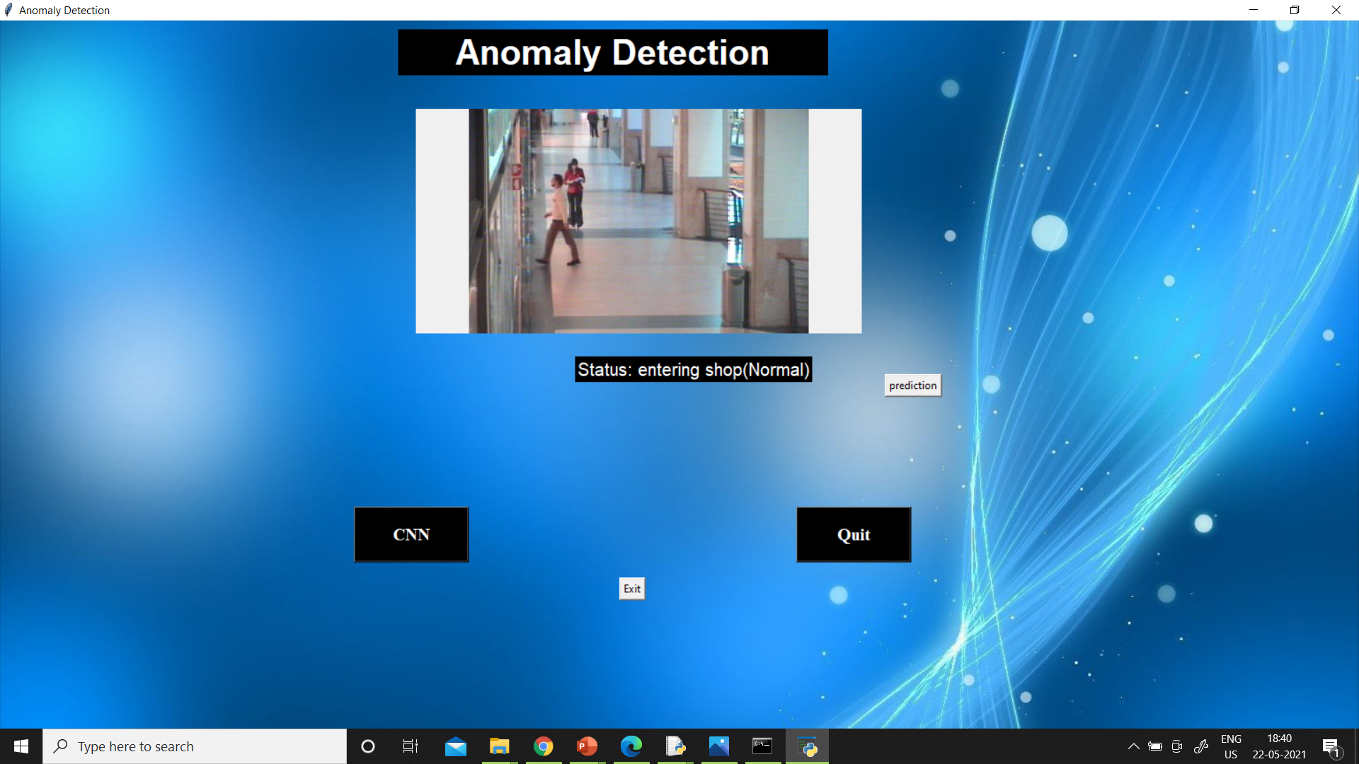

Slide 23
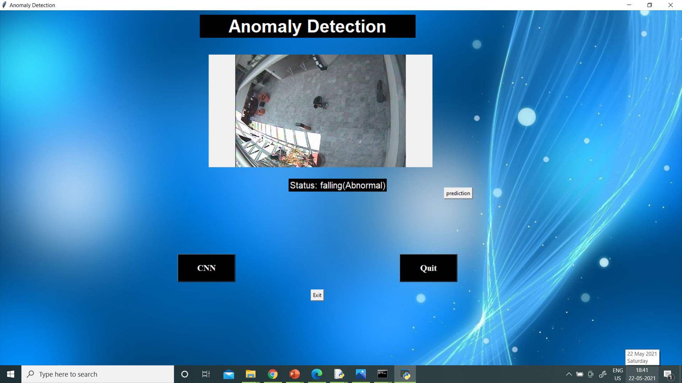
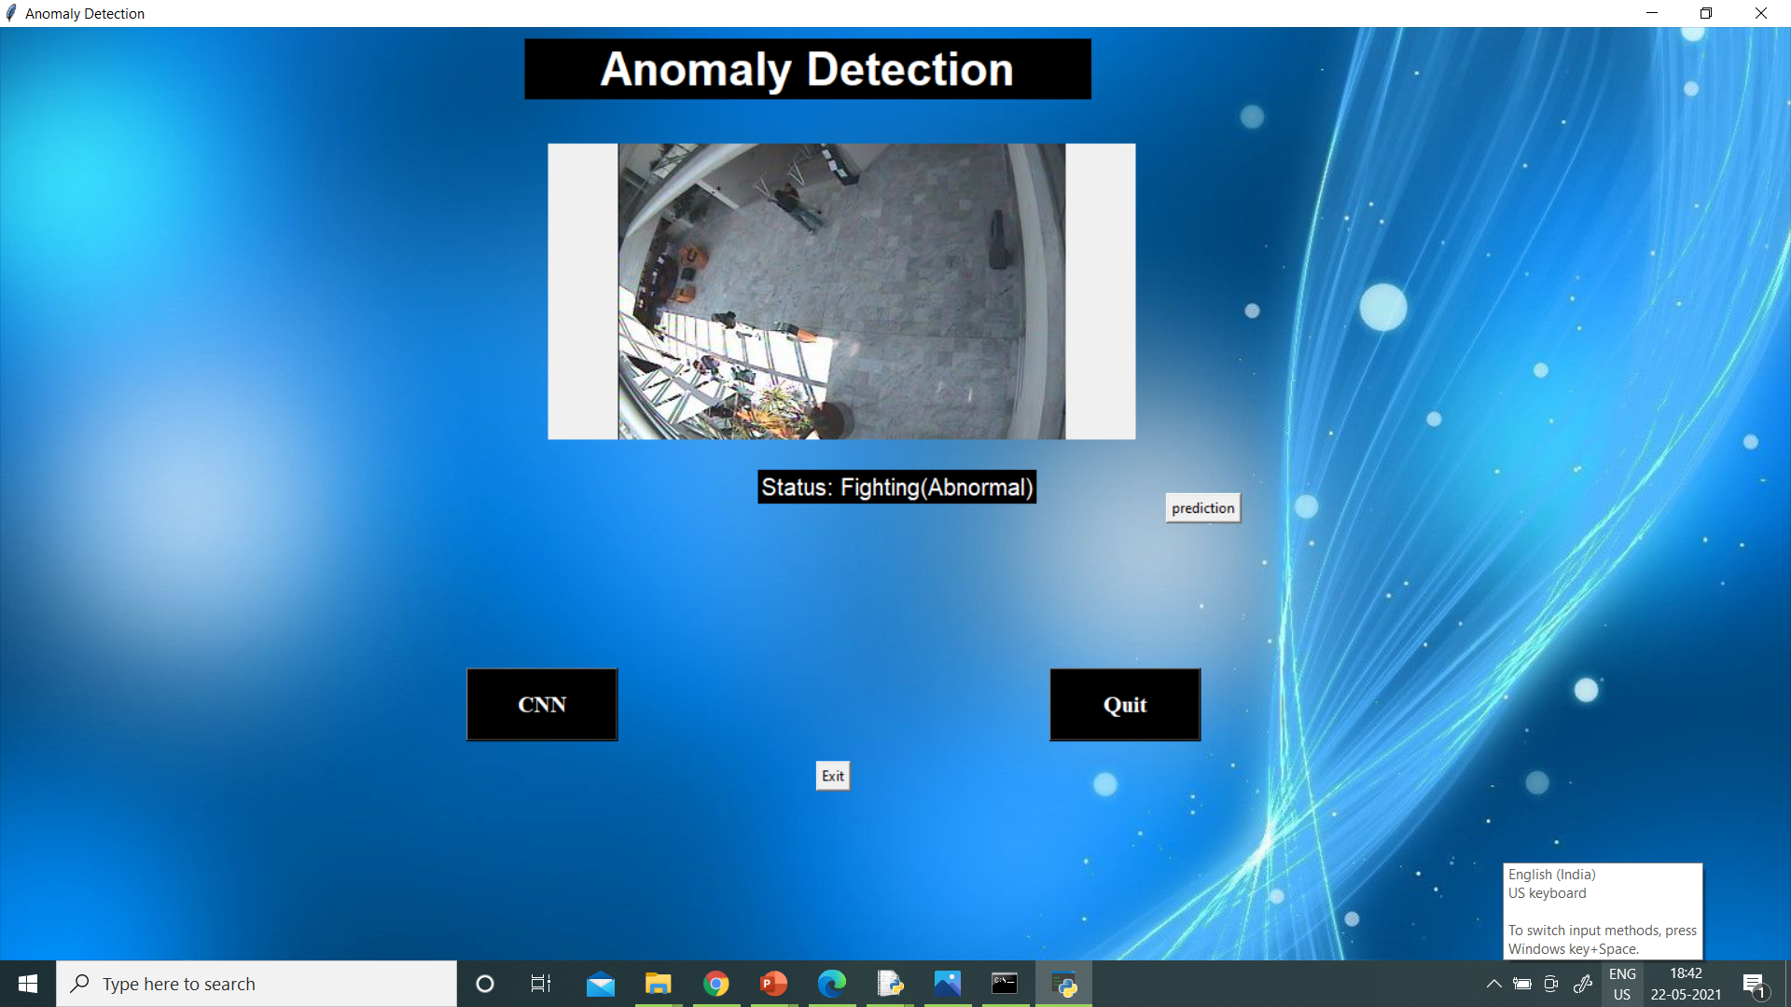

Slide 24
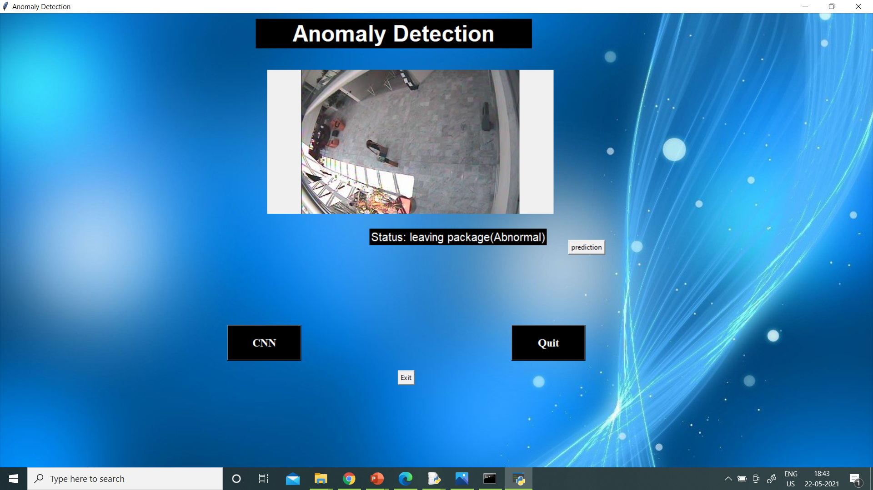
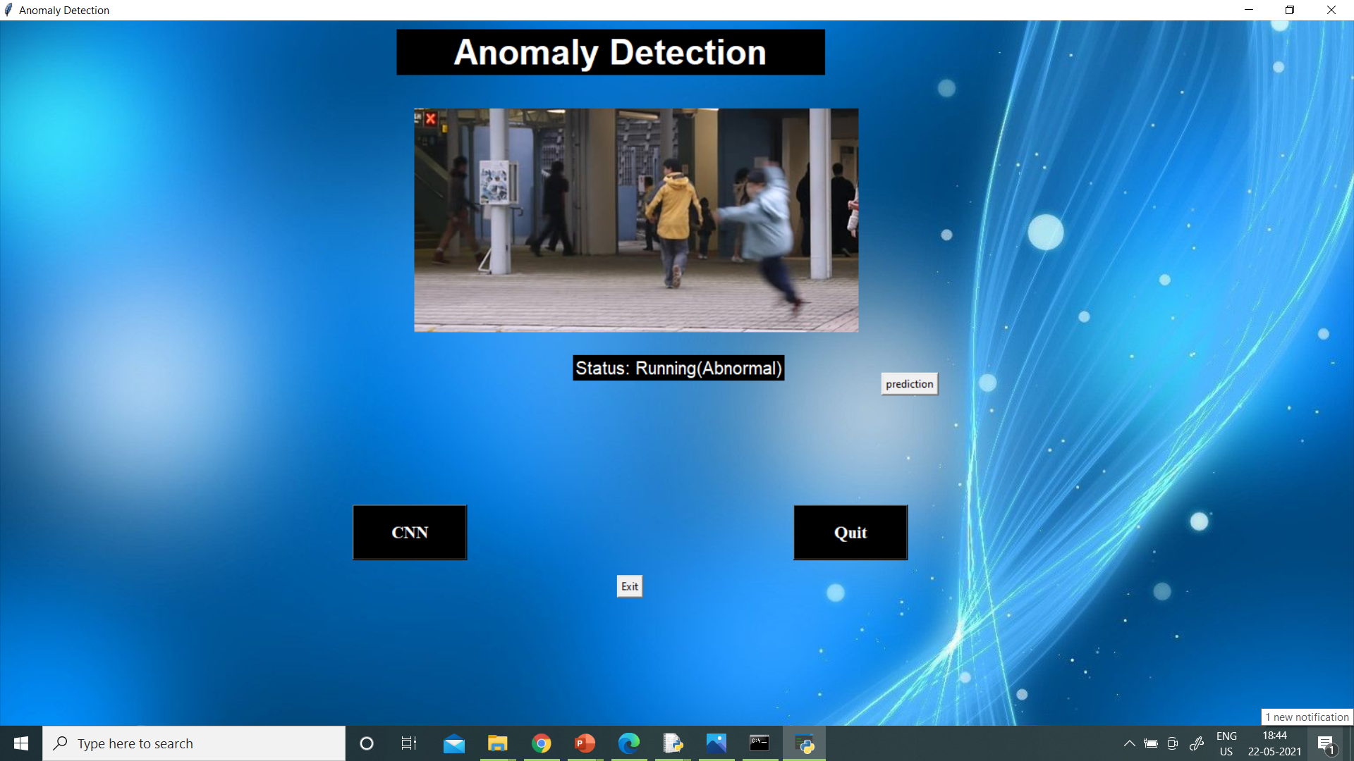

Slide 25
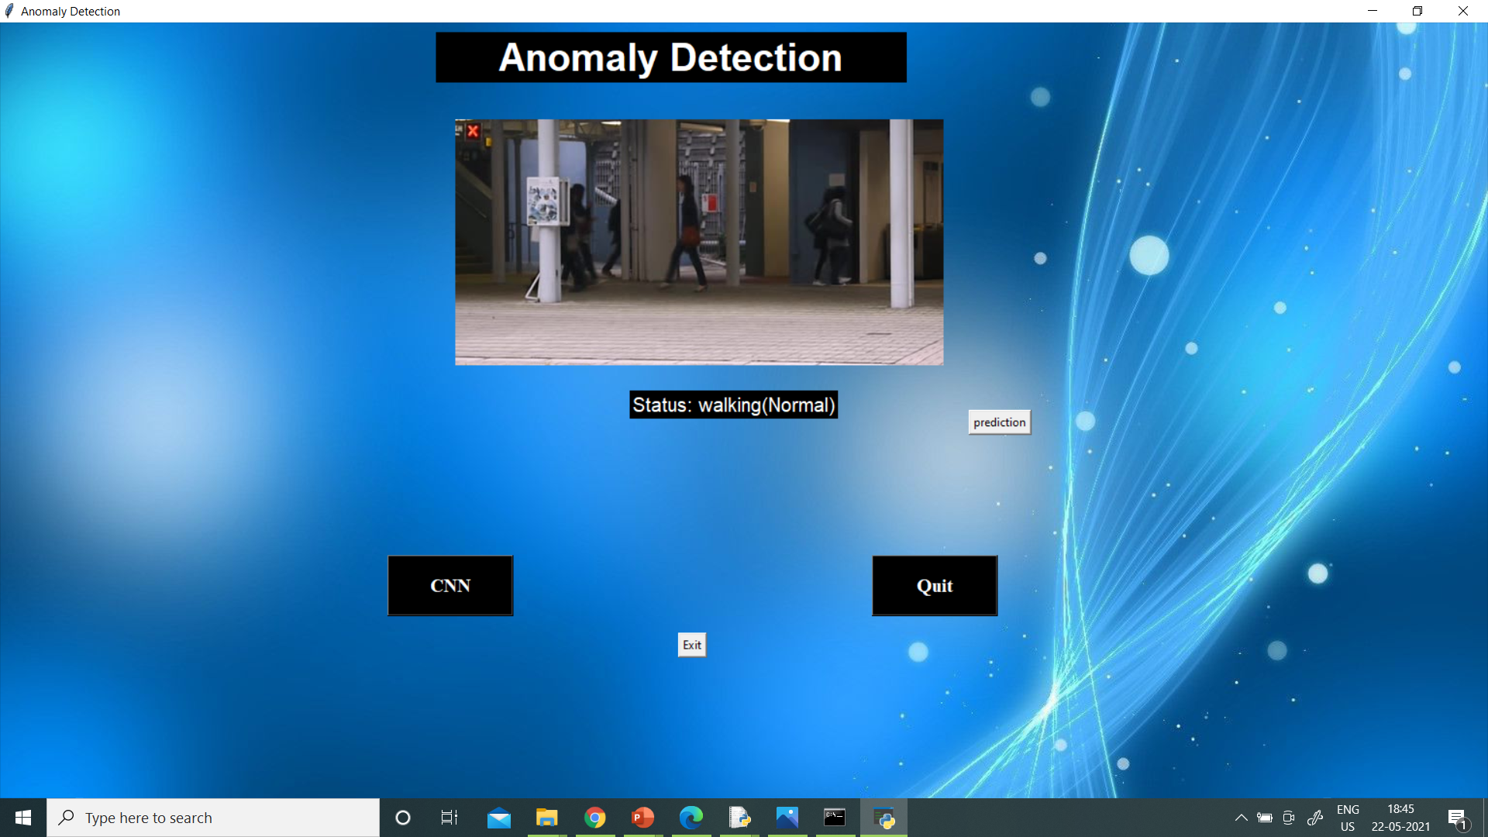
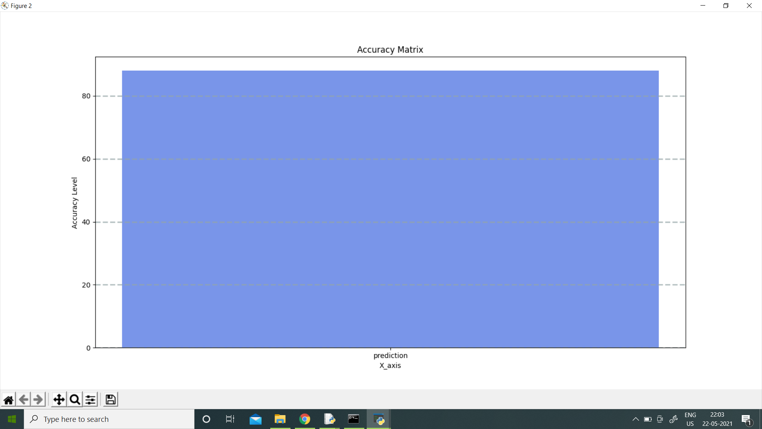

Slide 26
CONCLUSION
It is clear that the proposed new framework will be able to detect unusual events such as overcrowding situation , fighting or any abnormal activity in a image.
The need of developing such security system is the increasing day by day for much secure society where people can lead their day to day lives without worrying.
This proposed framework could be helpful to enhance many security systems , for different applications like ATM’s, banks, malls, parking, traffic etc

Slide 27

FUTURE WORK
The systems can be tailored for further future work where taking input as videos.
This model can trained and tested with different other datasets also for increasing accuracy and efficiency of the model.
Can use this model with different machine learning algorithms.
Add more different activities also.

Slide 28
REFERENCES
S. Ojha and S. Sakhare, “Image processing techniques for object tracking in video surveillance-a survey,” in Pervasive Computing (ICPC), 2015 International Conferenceon. IEEE, 2015, pp. 1–6.
K. A. Joshi and D. G. Thakore, “A survey on moving object detection and tracking in video surveillance system,” International Journal of Soft Computing and Engineering, vol. 2, no. 3, pp. 44–48, 2012.
G. L. Foresti, “Object recognition and tracking for remote video surveillance,” IEEE Transactions on Circuits and Systems for Video Technology, vol. 9, no. 7, pp. 1045–1062, 1999.
A. Treuille, S. Cooper, and Z. Popovic, “Continuum crowds,” ´ ACM Transactions on Graphics (TOG), vol. 25, no. 3, pp. 1160–1168, 2006.

Slide 29
THANK YOU

